Slide 1
ONLINE RETAIL DATA ANALYSIS.
Business Insights from E-Commerce Transaction Data
Prepared for: AnalystLab Africa Data Analytics Internship Program.
Tools Used: Python(Pandas), SQL, and Microsoft PowerPoint.
Project Focus: Data Cleaning, Exploratory Data Analysis, and Business Insights.

Slide 2
PROJECT OVERVIEW AND OBJECTIVES
This project analyses online retail transaction data to understand sales performance, customer purchasing behaviour, and product performance. Python and SQL were used to clean, analyse, and validate the dataset.
Project Objectives
Clean and prepare the raw transaction data for analysis.
Identify sales trends and monthly growth patterns.
Determine the top-performing products and countries.
Calculate average order values and investigate unusually high-value invoices.
Generate actionable business insights and recommendations.

Slide 3
DATASET OVERVIEW
The dataset contains online retail transactions used to analyse sales performance, products, customers, and international markets.
Key Dataset Statistics.
Matric Results
Total cleaned records 536,639
Total invoices 25,898
Uniques customers 4,372
Unique products 4,070
Countries represented 38
Total net sales value £9,748,131.07
Data Period: December 2010 – December 2011
Data Source: Kaggle – Online Retail Dataset

Slide 4
DATA CLEANING AND PREPARATION
Data Cleaning Activities
Column Standardization: Standardized column names for easier analysis.
Missing Values: Identified missing descriptions and customer IDs.
Duplicate Removal: Removed duplicate records.
Data Type Conversion: Converted invoice dates and numerical columns to appropriate data types.
Invalid Records: Removed records with missing essential fields, zero quantities, or negative unit prices.
Feature Engineering: Created SaleValue, IsCancelation, and YearMonth columns.
Final Result
Cleaned dataset: 536,639.
Duplicate records remaining: 0
Original raw dataset preserved.
Cleaned dataset saved separately as CleanedOnlineRetail.csv

Slide 5
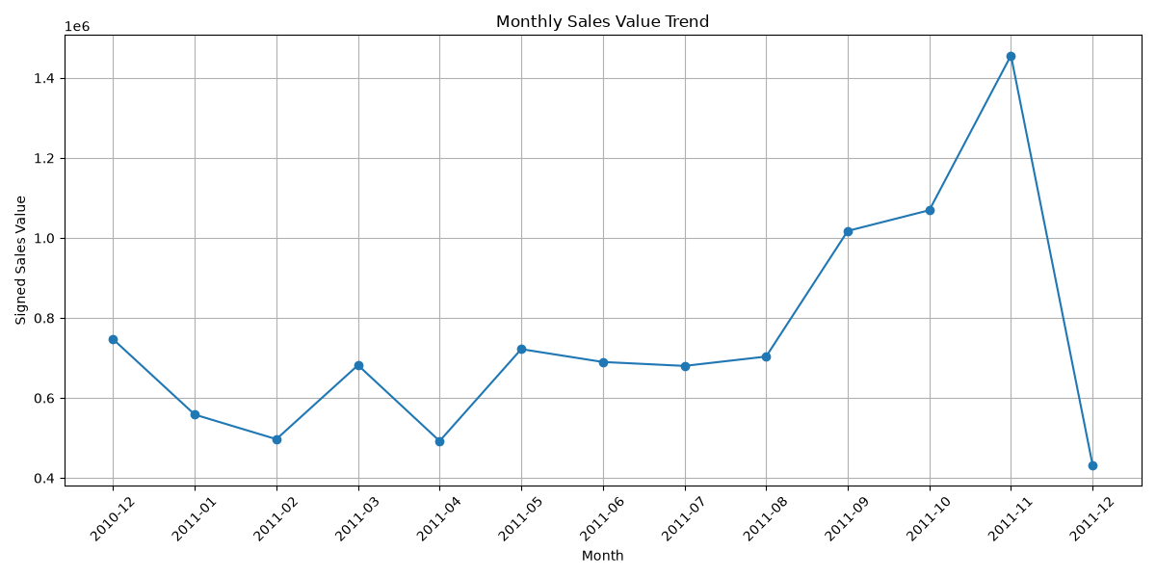
MONTHLY SALES TREND AND GROWTH
Key Findings
• Highest Sales: November 2011 recorded net sales of £1,456,145.80.
• Second-Highest Sales: October 2011 recorded £1,069,368.23.
• Lowest Sales: December 2011 recorded £432,701.06.
• Strong Growth: Sales increased by 44.65% in September 2011 compared with August.
• Sharp Decline: Sales decreased by 70.28% in December compared with November.
Business Interpretation
November recorded the highest monthly sales in the dataset. However, the sharp December decline should be investigated further because the available data may not cover the entire month.

Slide 6
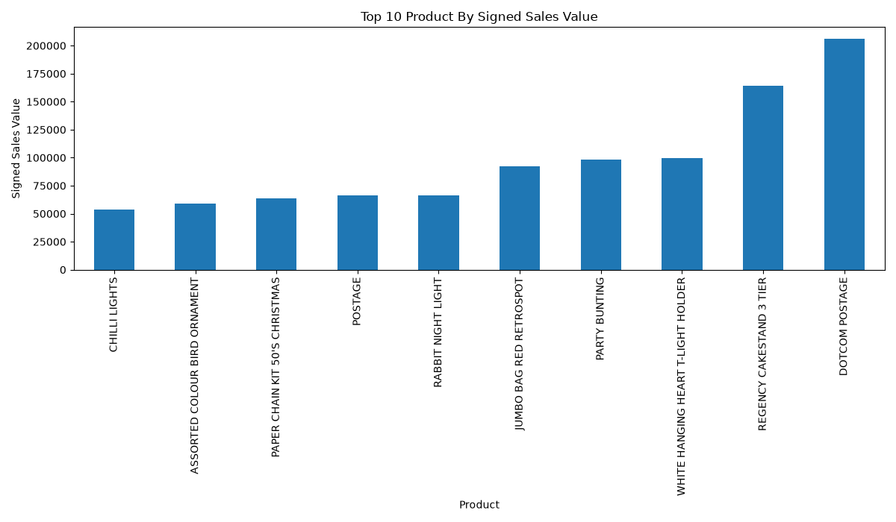
TOP 10 PRODUCTS BY SIGNED SALES VALUE
Key Findings
- DOTCOM POSTAGE recorded the highest net sales at £206,245.48.
- Regency Cake Stand 3 Tier ranked second at £164,459.49.
- Party Bunting generated £98,243.88 in net sales.
- White Hanging Heart T-Light Holder generated £97,659.94.
- Jumbo Bag Red Retrospot generated £92,175.79.
Business Insight
Postage-related codes appear among the top sales entries. These should be analysed separately from physical retail products to provide a clearer picture of product performance.
Recommendation
Monitor the sales performance of leading retail products and use the findings to support inventory planning.

Slide 7
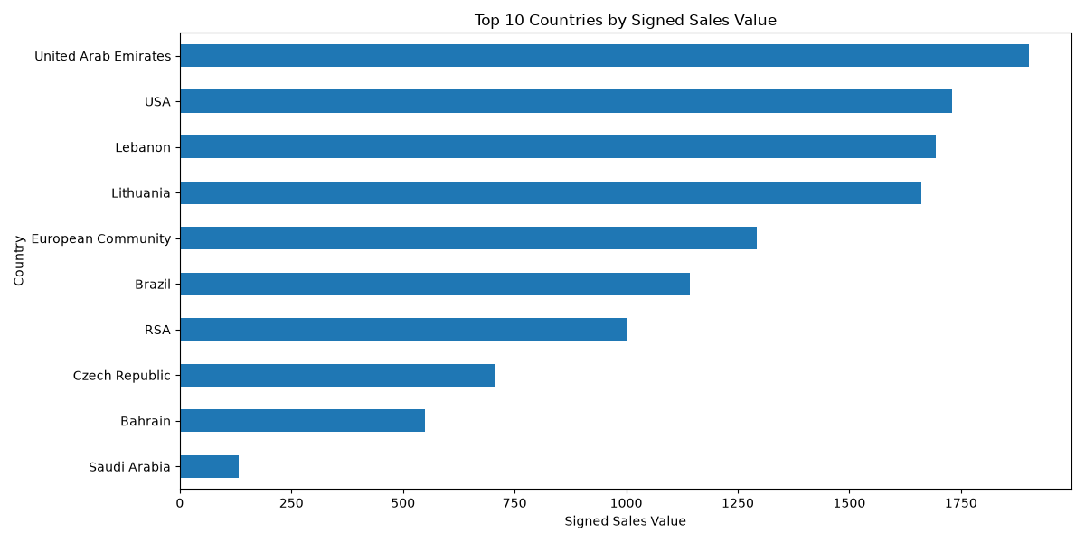
TOP 10 COUNTRIES BY SIGNED SALES VALUE
Key Findings
- The United Kingdom recorded the highest net sales of £8,189,252.30.
- The Netherlands ranked second at £284,661.54.
- EIRE (Ireland) recorded £262,993.38.
- Germany generated £221,509.47.
- France generated £197,317.11.
Business Insight
The United Kingdom contributed approximately 84% of total net sales, indicating a strong concentration of sales in one market.
Recommendation
Protect the performance of the UK market while investigating opportunities to grow sales in other countries.

Slide 8
AVERAGE ORDER VALUE AND HIGH-VALUE INVOICE==ORDER VALUE ANALYSIS
AVERAGE ORDER VALUE
£533.10
Calculated from 19,960 positive-invoices, excluding cancellation under the method used in our analysis.
HIGHEST-VALUE INVOICE
Invoice 581483: £168,469.60
One transaction row recorded 80,995 units at £2.08 each.
Business Insight
The average order value provides a useful measure of the value of a typical order under the selected calculation method. Invoice 581483 is unusually large and may significantly affect summary statistics.
Recommendation
Investigate the unusually high-value invoice, including its customer and product details, before deciding whether it represents a typical transaction or requires further validation.

Slide 9
KEY BUSINESS INSIGHTS AND RECOMMENDATIONS.
1. Sales Concentration
The UK accounts for approximately 84% of total net sales.
Recommendation: Explore growth opportunities in other markets while protecting UK performance.
2. Monthly Sales Performance
November 2011 recorded the highest monthly net sales at £1.46 million.
Recommendation: Investigate the factors behind November's strong performance.
3. Product Performance
Postage-related codes appear among the leading sales entries.
Recommendation: Analyse postage separately from physical products.
4. Order Value
The calculated average order value was £533.10.
Recommendation: Study customer purchasing patterns to identify opportunities to increase order value.
5. Unusually Large Transaction
Invoice 581483 recorded £168,469.60 in net sales value.
Recommendation: Validate the transaction and examine its effect on the analysis.

Slide 10
CONCLUSION AND NEXT STEPS
Conclusion
This project used Python, Pandas, and SQL to clean, analyse, and validate an online retail transaction dataset containing 536,639 cleaned records.
The analysis identified major sales markets, leading sales entries, monthly sales movements, average order value, and an unusually large invoice requiring further investigation.
Key Takeaways
- Data cleaning improves the reliability of analysis.
- Python and SQL can be used together to analyse and validate results.
- Visualizations help communicate business performance.
- Business recommendations should be based on evidence and further validation where necessary.
Next Steps
- Investigate unusually large transactions.
- Verify the completeness of December 2011 data.
- Analyse postage separately from retail products.
- Prepare the final business report and project files for portfolio sharing.

Slide 11
Thank You
AnalystLab Africa Data Analytics Internship Program

